Slide 1
Dynamically fused Graph Network
Data is scattered over the entire documents.
An entity graph is formed from the given corpus.
The Nodes in the graphs are the entities and the edge between them is their relation.
The starting entity is determined from the query and the graph is traversed to find the relevant answer.
Reasoning chains are inherently formed due to this structure.

Slide 2
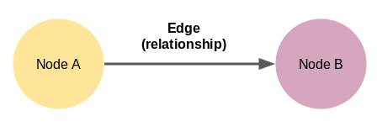
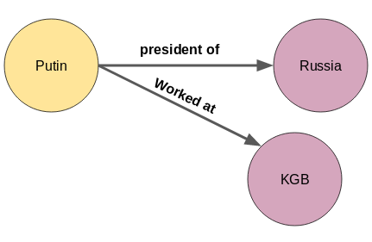
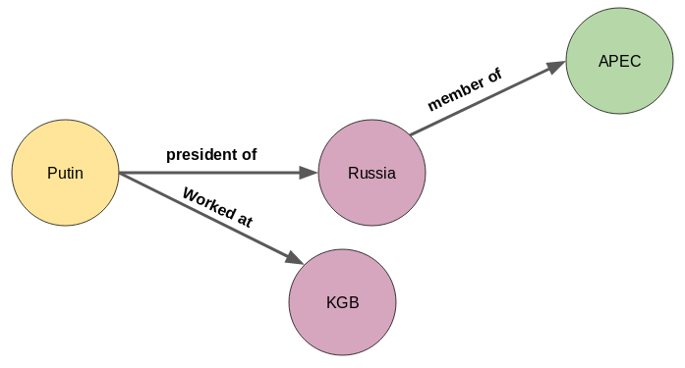
Entity Graph

Slide 3
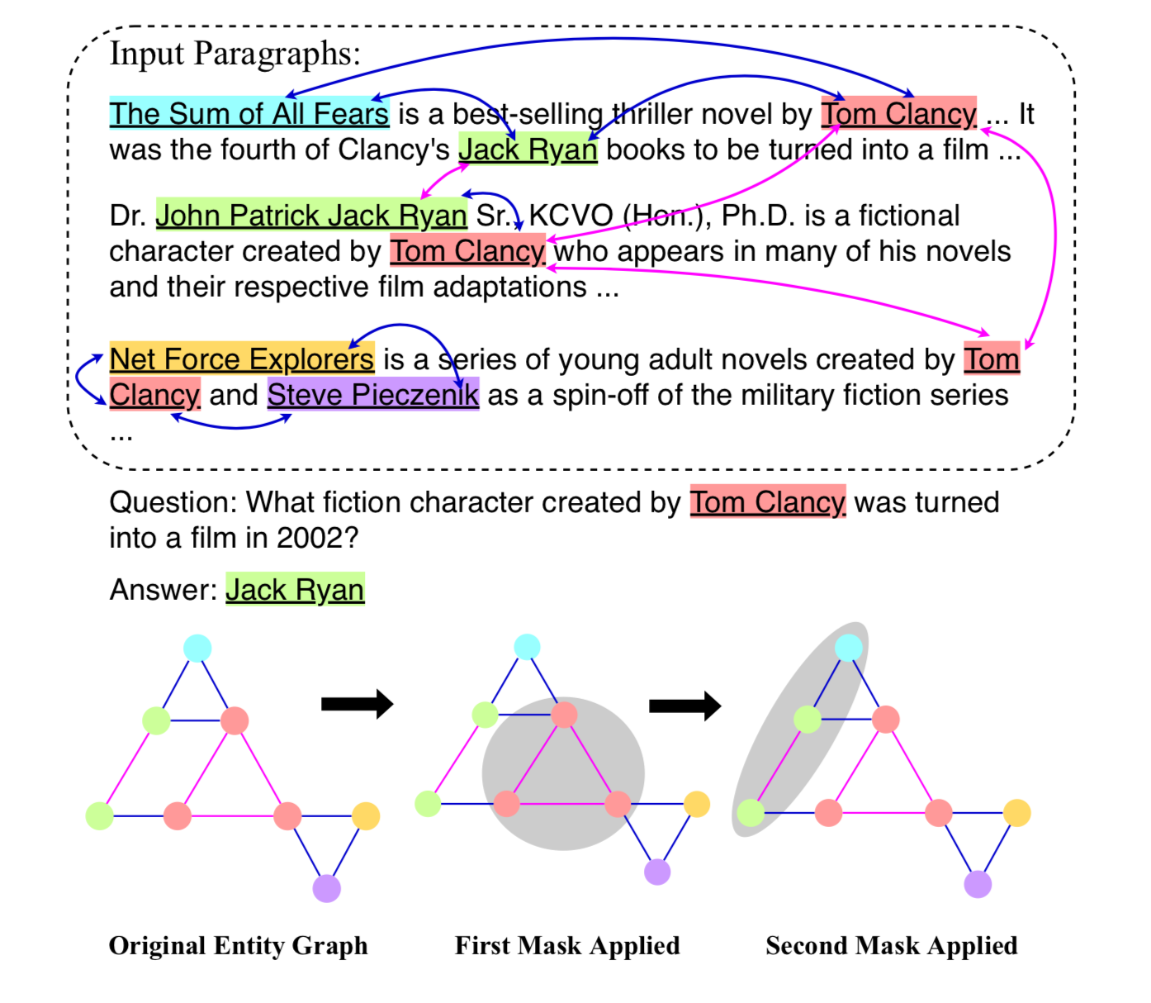

Slide 4
Construction
The Stanford corenlp toolkit (Manning et al., 2014) is used to recognize named entities from the context C.
These entities are the nodes in our entity graph
The edges are added as follows:
For every pair of entities appear in the same sentence in C ((sentence- level links)
For every pair of entities with the same mention text in C (context-level links)
Between a central entity node and other entities within the same paragraph (paragraph-level links) where central entity is extracted from the title sentence of each paragraph.
Co-reference resolution is not applied for pronouns because it introduces both additional useful and erroneous links.

Slide 5
Brief Implementation
Since not every document contain relevant information, multi-hop text based QA requires filtering out noises from multiple paragraphs and extracting useful information.
This is where the entity graphs are helpful.
The graphs are formed dynamically according to the query instead of a static global graph.
If the document is directly transformed into an entity graph and we try to answer the question based on only the entities, there are questions in which the answer doesn't reside in the extracted entities.
The information is not only propagated from the document to the entity graph but also back from graph to the document (namely doc2graph and graph2doc).
This process is iteratively performed at each hop through the document tokens and entities, and the final resulting answer is then obtained from document tokens.
DFGN’s predicted masks implicitly induce reasoning chains, which can explain the reasoning results.

Slide 6
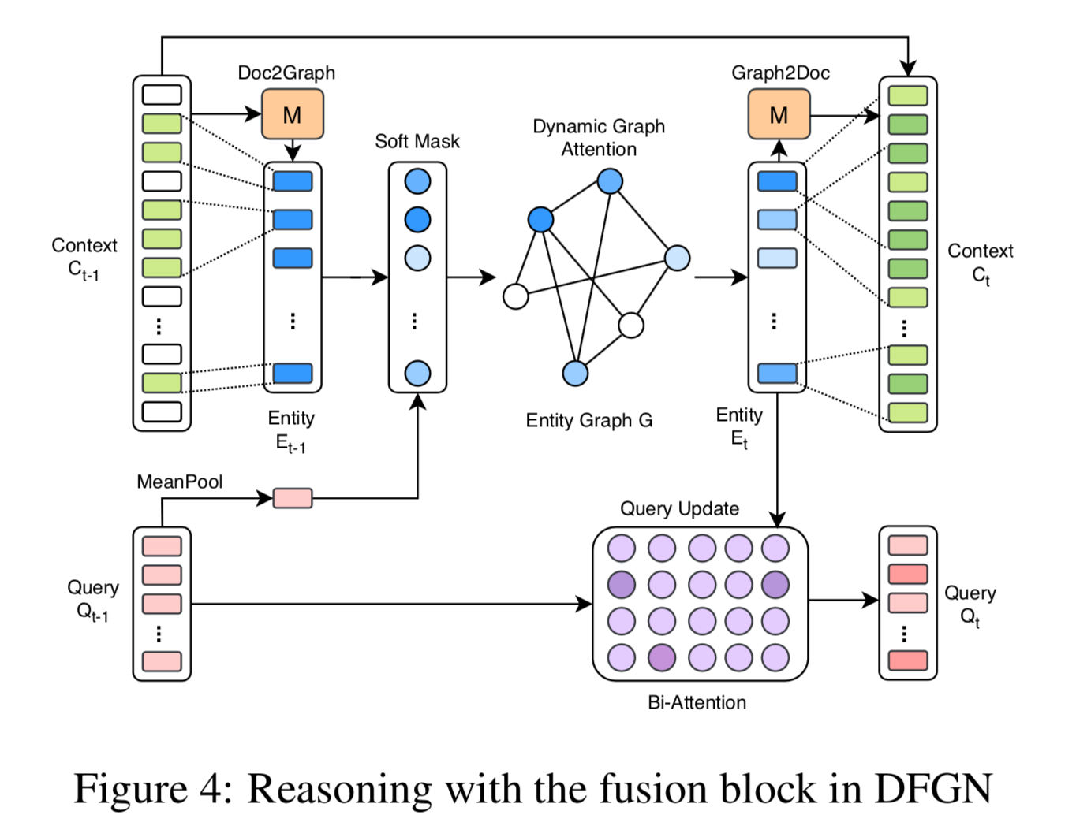
DFSN Model

Slide 7
Encoding Query and Context:
We concatenate the query Q with the context C and pass the resulting sequence to a pre-trained BERT model
The representations are further passed through a bi-attention layer (Seo et al., 2016) to enhance cross interactions between the query and the context.
Reasoning:
Pass information from tokens to entities by computing entity embeddings from to- kens (Doc2Graph flow)
Propagating information on entity graph.
Pass information from entity graph to document tokens since the final prediction is on tokens (Graph2Doc flow)
Dynamic Graph attention:
After obtaining entity embeddings from the input context, we apply a graph neural network to propagate node information to their neighbours.
In each reasoning step, we assume every node has some information to disseminate to the neighbouring nodes. The more relevant to the query, the neighbour nodes receive more information from nearby.
We first identify nodes relevant to the query by creating a soft mask on entities. It serves as an in- formation gatekeeper, i.e. only those entity nodes pertaining to the query are allowed to disseminate information.

Slide 8
Updating Query:
A reasoning chain contains multiple steps, and the newly visited entities by one step will be the start entities of the next step.
Graph to Document Flow.:
Using Tok2Ent and dynamic graph attention, we realize a reasoning step at the entity level.
To backtrack the information from entity to the document, we use a Graph2Doc module to keep information flowing from entity back to tokens in the context.

Slide 9
